Slide 1

PROJET JAVA/POO/UML
SUPERVISED BY :
Mme MAFFOCK JUNIE

Slide 2
TEAM PRESENTATION
KENGNE DEFO Heidy Giraud(Chef Projet)
NODJIMADJI Souar Ndolebeye
FENYOM MEYOU Bryan
NGUESSIE CHENDJOU Fabiola

Slide 3
ROLES ATTRIBUTED
3.Game Code
Controller
Entity
Model
View
Contract
Main
1.UML Diagrams
Component diagram
Package diagram
A Class diagram per package
Sequence diagram
2.Database
The conceptual data model
The logical data model
The physical data model
Store procedure
INDICATIONS:
Green : All the Members
Pink : Kegne Heidy
Blue : Nodjimadji Souar
Brown : Fenyom Bryan
Purple : Nguessie Fabiola
4.Presentation
Slideshow
Reports review
5.Reports
SureFire
JavaDoc
JXR
Git

Slide 4
TABLE OF CONTENT
PROJECT PRESENTATION
GANTT
DESCRIPTION OF TOOLS USED
APPLICATION PRESENTATION
UML DIAGRAMS
REPORTS
STRENGTH AND WEAKNESS
CONCLUSION

Slide 5
PROJECT PRESENTATION
CONTEXT
It's about rewriting an old game (1984) Boulder Dash created by Peter Liepa and Chris Gray, about which the principle of the game is to collect a defined number of diamonds to open a passage to the next level. The character, nicknamed Rockford, must dig the earth to make his way. He will have to be careful not to be crushed by a rock or a diamond but also not to make enemies touch.
OBJECTIVES
Rewrite an old game named Lorann
Lorann have to pick up some objects, especially diamonds to finish the level, and fight monsters to gain more diamonds
It must be a Maven Project written in JAVA language, and composed of five levels.
Use of a database to access different levels
Player’s displacement/movement
Class Diagram

Slide 6

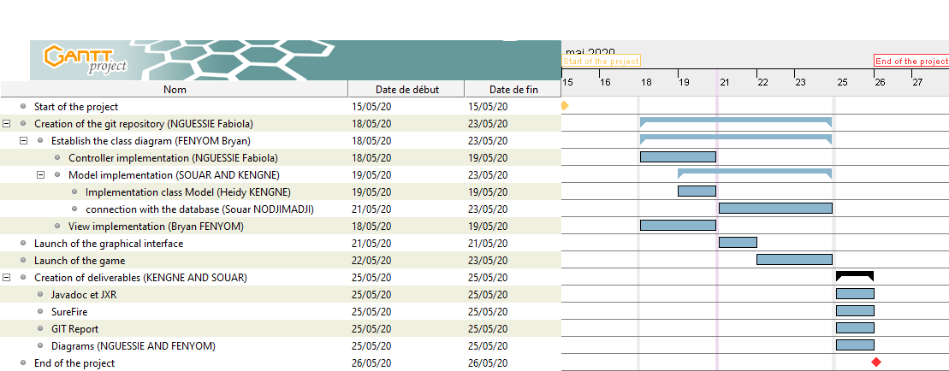
GANTT (1/2)
Provisional Planning

Slide 7
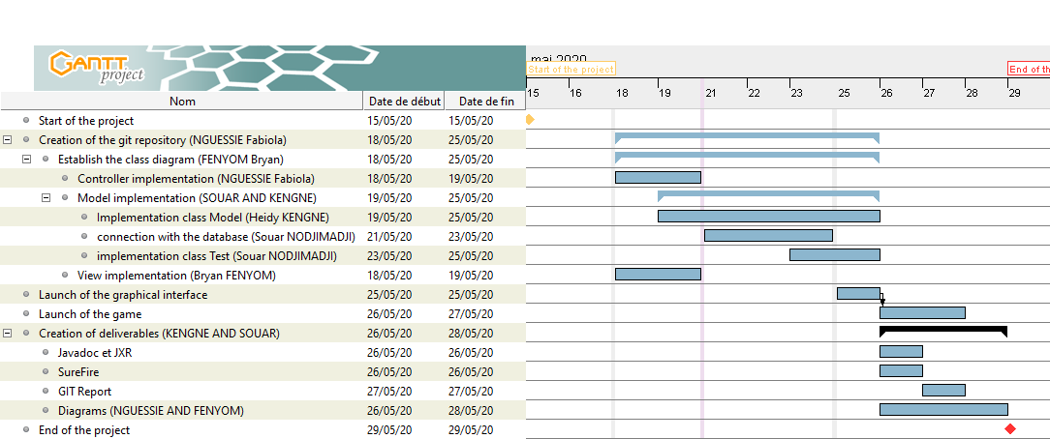
GANTT(2/2)
Final and Real Planning

Slide 8









DESCRIPTION OF THE TOOLS USED

Slide 9


APPLICATION PRESENTATION

Slide 10
UML DIAGRAMS
Class diagrams
Package diagram
Sequence diagram
Component diagram

Slide 11
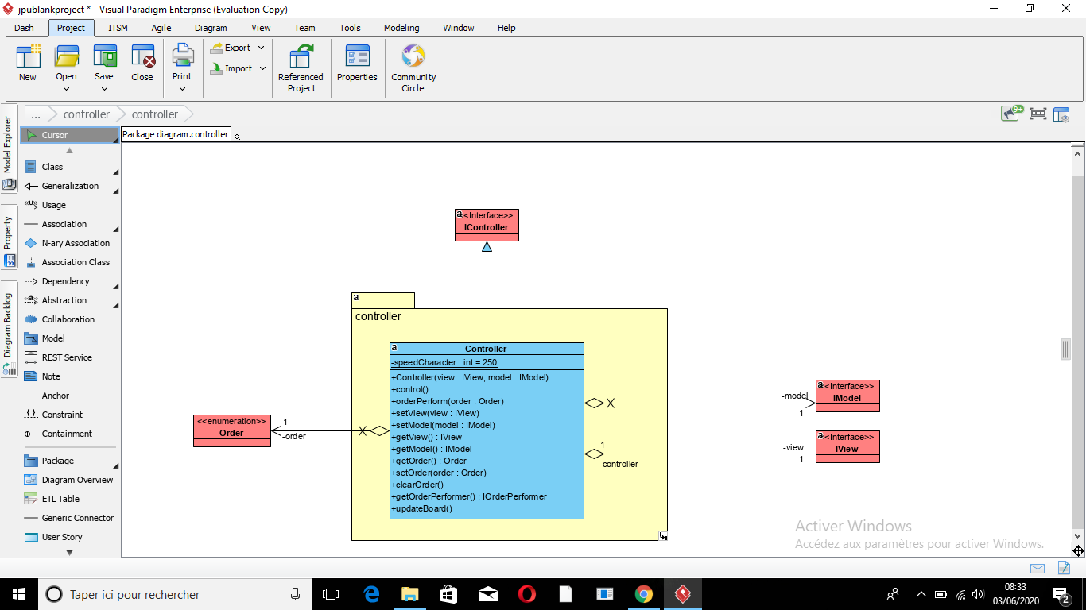
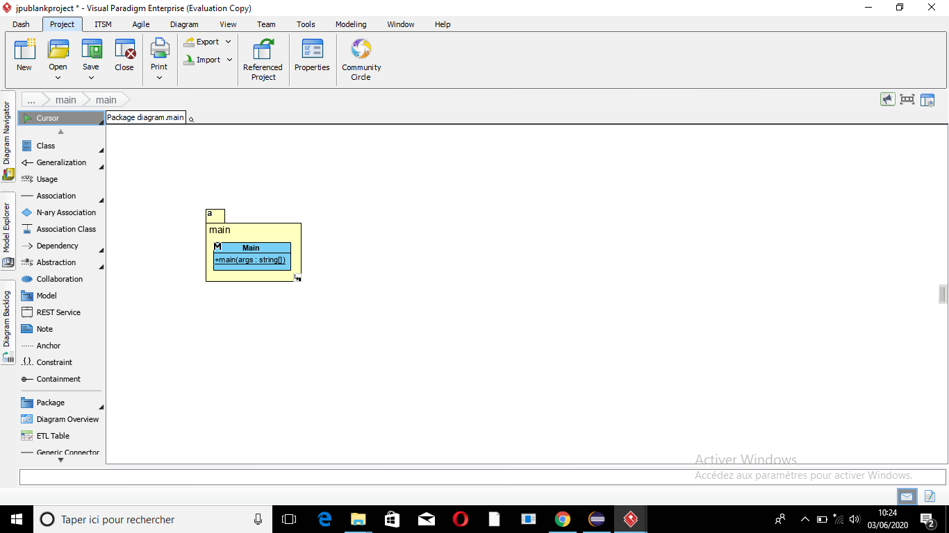
CLASS DIAGRAM
Controller
Main

Slide 12
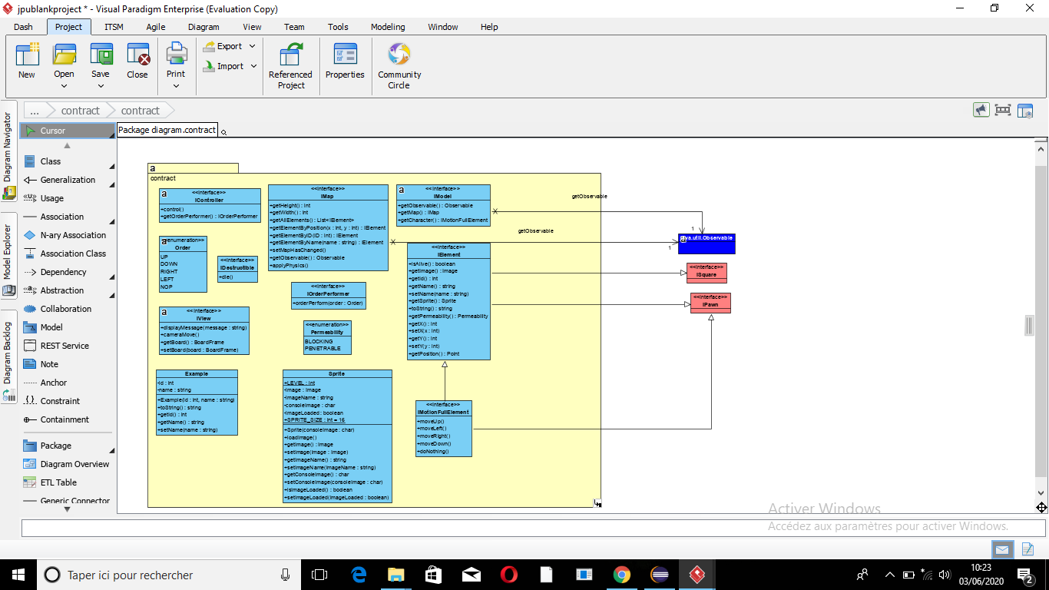
Controller

Slide 13
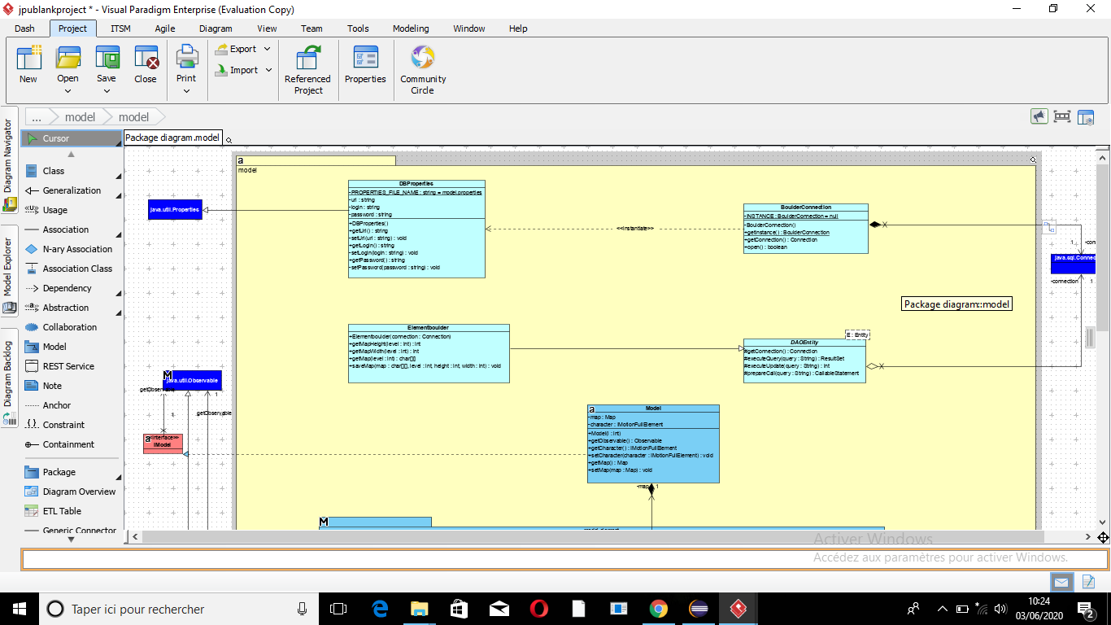
Model

Slide 14
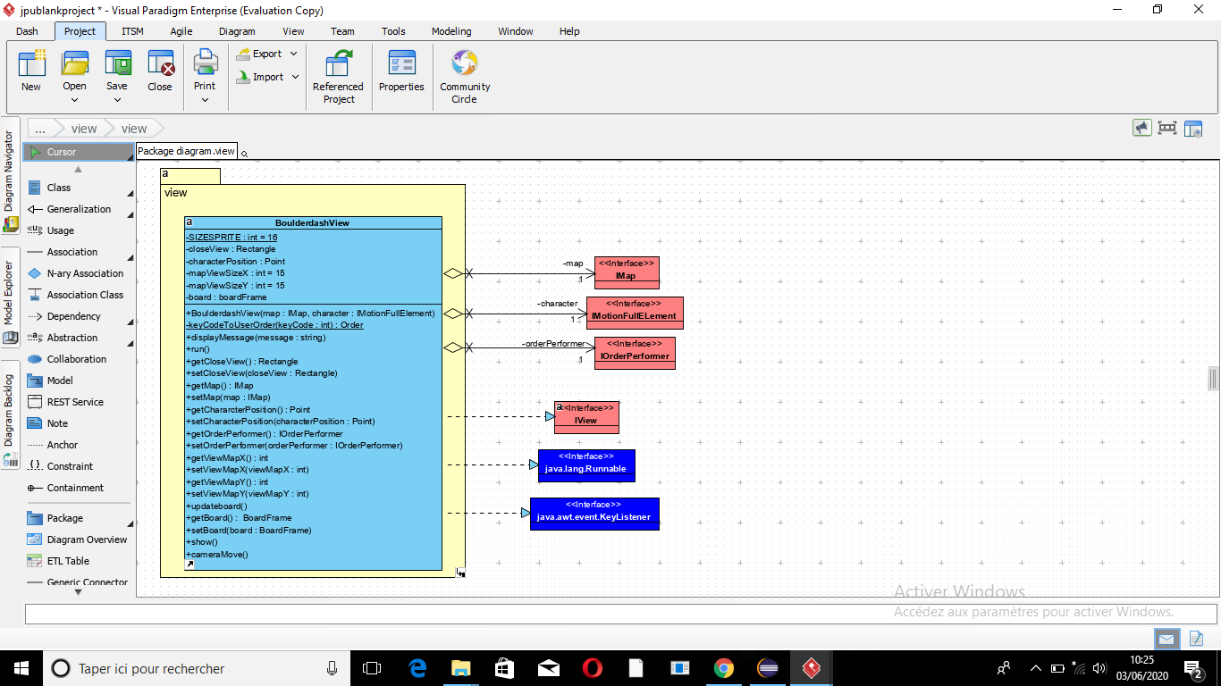
View

Slide 15
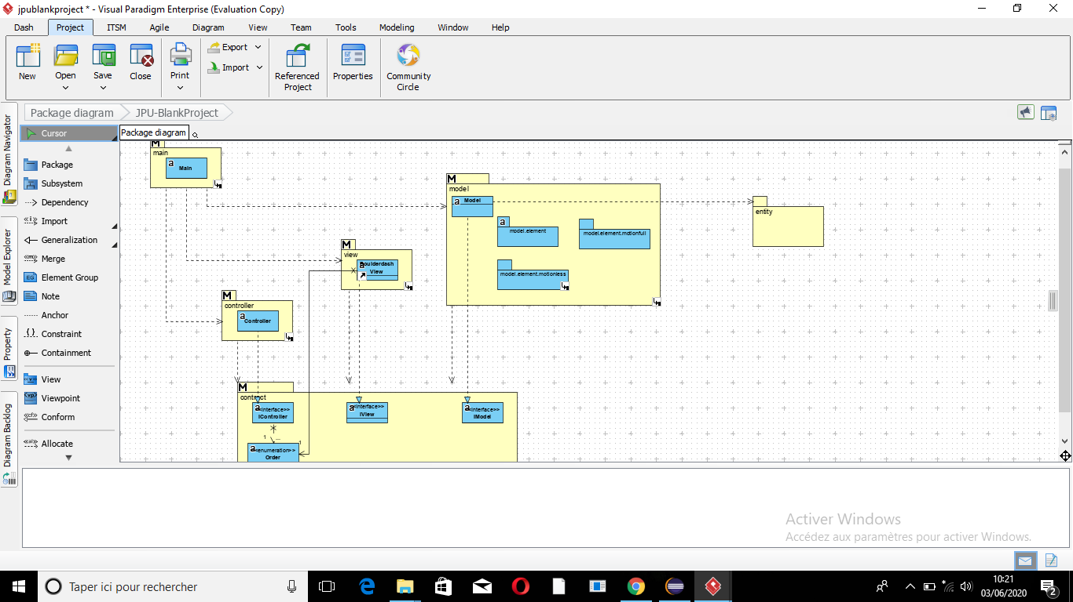
PACKAGE DIAGRAM

Slide 16
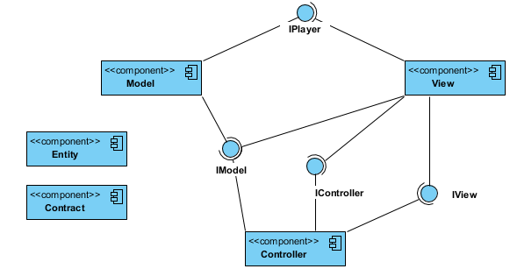
COMPONENT DIAGRAM

Slide 17
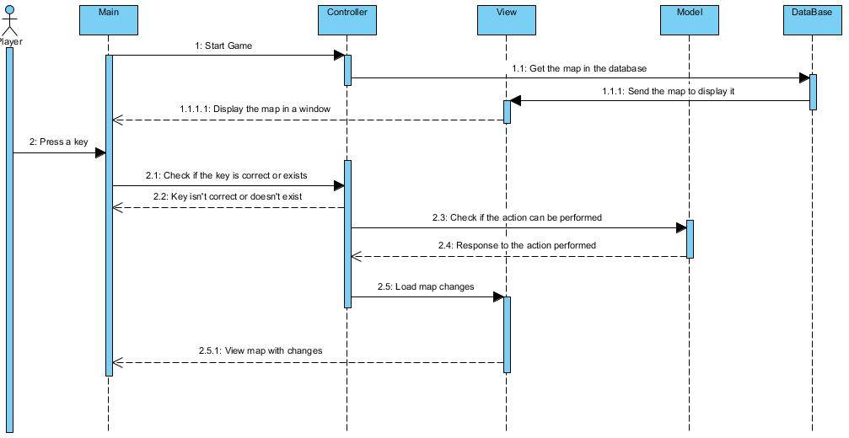
SEQUENCE DIAGRAM

Slide 18

REPORTS (1/2)
JavaDoc
Surefire
JXR

Slide 19
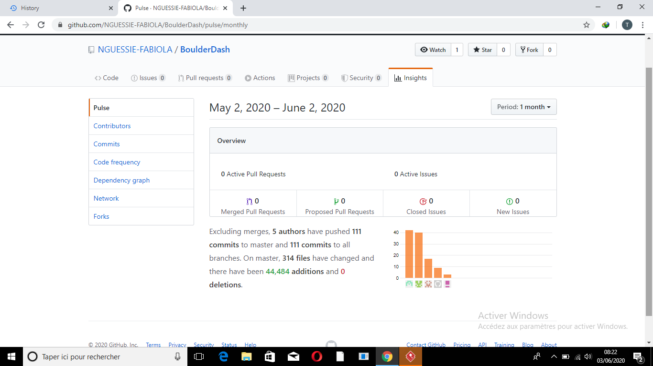
GIT REPORT (2/2)

Slide 20
STRENGTH AND WEAKNESS
STRENGTH
Kegne Heidy
Nodjimadji Souar
Fenyom Bryan
Nguessie Fabiola
WEAKNESS
Kegne Heidy
Nodjimadji Souar
Fenyom Bryan
Nguessie Fabiola

Slide 21

Difficulties encounter during the projet
Reasons for the difficulties
How well can you remedy to the situation

